Slide 1


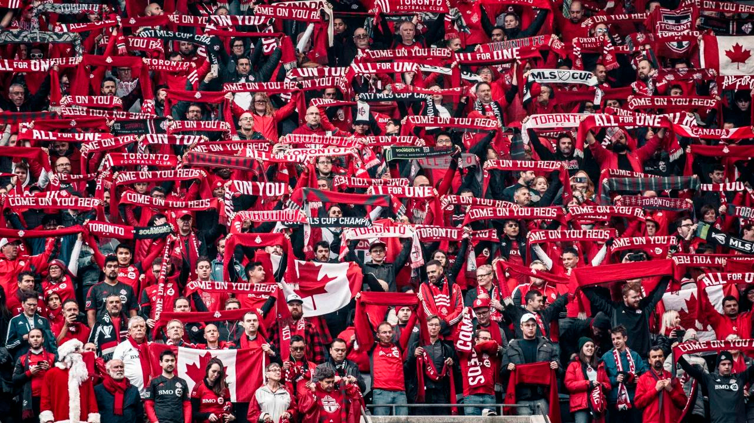




REWARDING
TORONTO FC’S
LOYAL FANS
FEASIBILITY STUDY
ON WEATHER-DRIVEN
ATTENDANCE INSIGHTS
ENGAGING THE UNSTOPPABLE
WEEK 4 PRESENTATION
Notes:
Thank you for joining us today. Welcome to week 4 to our project presentation.

Slide 2



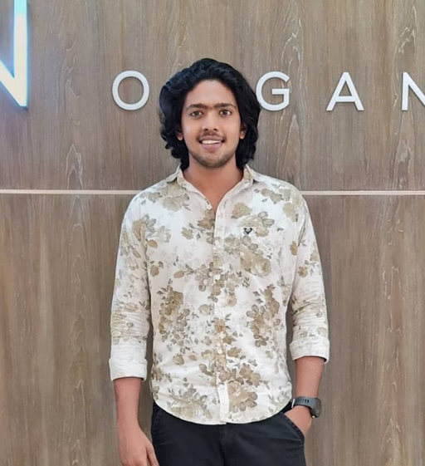
VENKATA MANISH
KATRAGADDA
CHIBUIKE OKOROAMA
PRESCILA MORA
MOHAMED AFTHAB
TEAM MEMBERS
Notes:
We're Cooper Inc., our is team is dedicated to data-driven solutions. My teammates are Chibuke, Manish, Mohamed and I’m Prescila and. I”ll be presenting our project for this week.

Slide 3



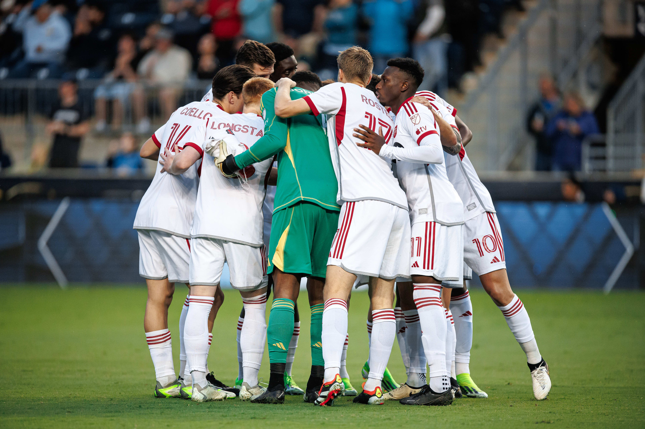
KEY FACTS
Since 2007
Major League Soccer (MLS)
BMO Home Field, 30,991 seating capacity expanded to 40,000
Average Fan Attendance: 25,310 in 2023
ACHIVEMENTS
2017 MLS Cup Champions
8-time Canadian Championship winners
Notes:
Some key information about out client Toronto Football Club, is a member of MLS or Major League Soccer since 2007, This football team has captivated fans with their exceptional performances. They are Grand champion of MLS Cup last 2017 and hold eight Canadian Championship titles. BMO Field is there home base, with a seating capacity expanding to 40,000 and last year 2023 the average crowd attendance is 25,310.

Slide 4
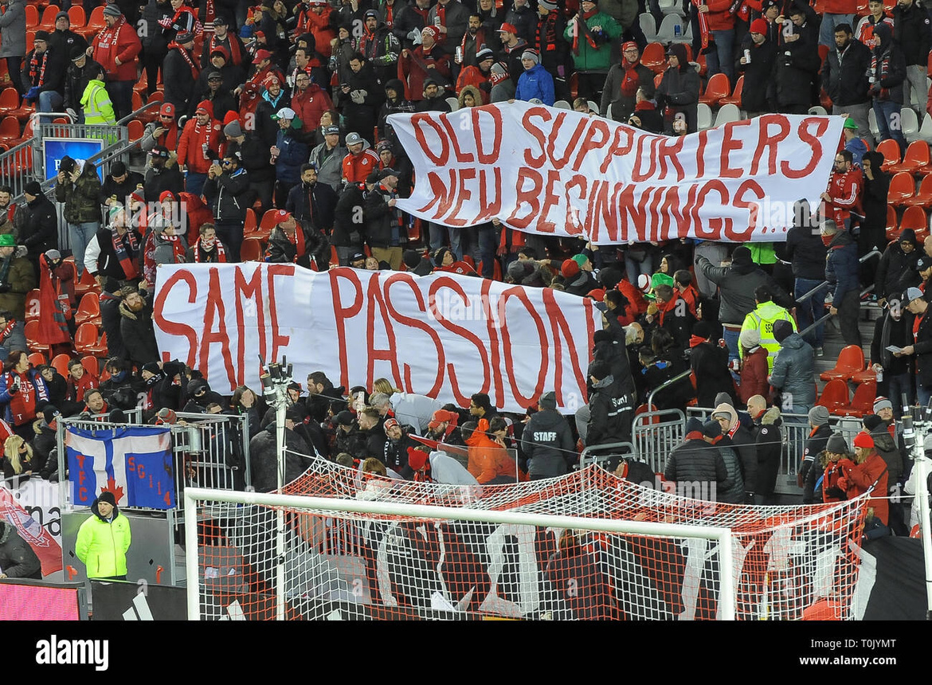
OBJECTIVE
FEASIBILITY ANALYSIS
ON TORONTO FC’s
WEATHER-DRIVEN
FAN LOYALTY ALGORITHM
To assess the feasibility and potential benefits of developing an algorithm that correlates historical weather data with attendance records, aimed at identifying and rewarding Toronto FC's loyal fans who attend matches despite challenging weather conditions.
Notes:
Our Objective
is to explore a data-driven approach to fan engagement and loyalty recognition.
Specifically, we're assessing the feasibility and potential benefits of developing an algorithm that would correlate historical weather data with fans attendance records.

Slide 5
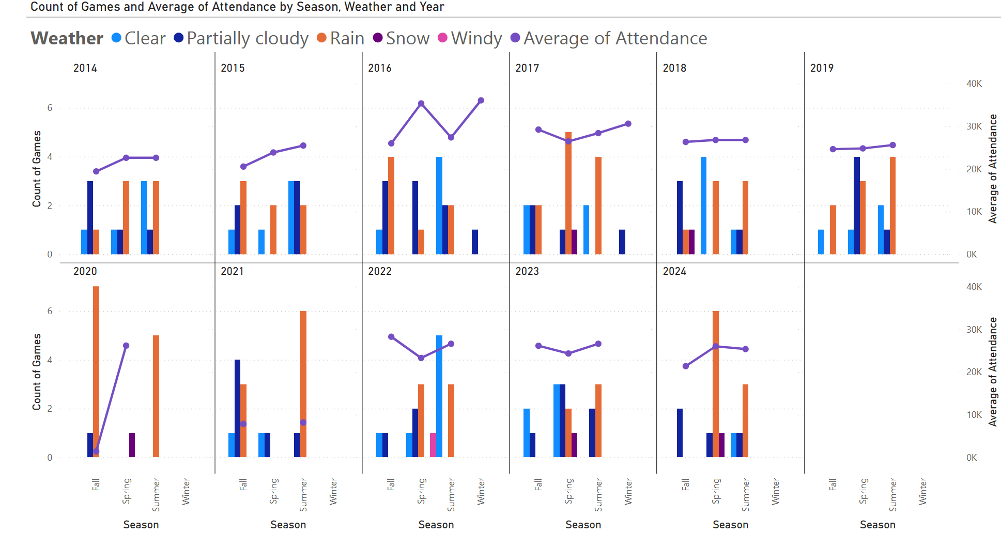
2014 to 2024 Toronto FC’s Home Games
Notes:
After gathering and processing the data that we’ve collected. We created this chart to help us analyze the data. Please take note that these are all MLS games only and Although the team started playing in the MLS since 2007 These charts represent a comprehensive overview of Toronto Football Clubs home games only which is in the BMO field in Toronto from 2014 to 2024, As you can see the left side of the graph marks the numbers of games, and on the right side has the average fan attendance in thousands. The bar represents the number of games in different seasons and weather conditions.
The Seasonal Patterns wherein
- Games are primarily held in Spring, Summer, and Fall.
- Winter games occurred only in 2016 and 2017.
- The Average Fan attendance Trends which is represented by the purple line varies significantly across different seasons and years.
- Clear weather and partially cloudy generally shows higher attendance, especially in summer months.
- Snow and windy conditions are relatively rare and have lower attendance when they do occur and that is the reason on the sudden drop of the average attendance in 2017 since there is a one snowy game that represented by the violet bar, in 2022 there is one windy game the pink bar and then again in 2023 as you can see there is again a violet bar that signify a snowy weather.
- Orange bar represent Rain doesn't seem to have a lower attendance and number of games as much as one might have expected.
This only means that rain or shine Fans are totally committed to support the Toronto football club team.
- Some years (like 2016 and 2017) show particularly high attendance peaks this is the year where Toronto Football Club won the MLS cup, Fan support is very evident that year.
The number of games and their distribution across seasons changes from year to year.
- There's a noticeable drop in games and attendance in 2020 to 2021, due to the COVID-19 pandemic restrictions.
- After the pandemic, there seems to be a gradual recovery in terms the number of game numbers and fans attendance.
- There's an overall there is an increase in the number of games here in Canada from 2014 to 2024, with some fluctuations.

Slide 6
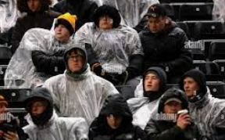



feasibility rationale
DATA AVAILABILITY
TECHNICAL CAPABILITY
DEFINED OBJECTIVE
RESOURCE CONSIDERATION
Weather records accessible from reliable sources
Comprehensive attendance data maintained by Toronto FC
Modern analytics tools can handle required complexity
Existing infrastructure can support implementation
Clear goal enables focused development
Measurable outcomes for evaluation
Achievable with proper planning and allocation
Potential ROI justifies resource investment
Notes:
"After thorough analysis, we've determined that developing an algorithm to correlate weather data with fan attendance, wherein…. It…. Is…. Not…… only innovative but entirely feasible. Let me walk you through our reason why it is feasible:
First, regarding data availability, We have access to comprehensive weather records from reliable meteorological sources, providing us with accurate historical data for every game day.
The Toronto Football Club management maintains a detailed attendance records of our fans, for all of the games. This combination gives us a robust dataset to work with.
Moving to our technical capabilities, we're well-equipped to handle this challenge. The modern analytics tools at our disposal are more than capable of processing the complex correlations required for this project.
Furthermore, our existing IT infrastructure can support the implementation of this new system without significant overhauls.
Our objective for this project is well-defined, which is crucial for its success. We aim to identify and reward fans who demonstrate exceptional loyalty by attending matches despite challenging weather conditions.
Lastly, let's consider the resource aspect. While this project will require an investment of time and resources, our analysis indicates that it's achievable with proper planning and allocation. Moreover, the potential return on investment is substantial. By enhancing our ability to recognize and reward our most dedicated fans, we anticipate significant long-term benefits in fan engagement and loyalty.

Slide 7


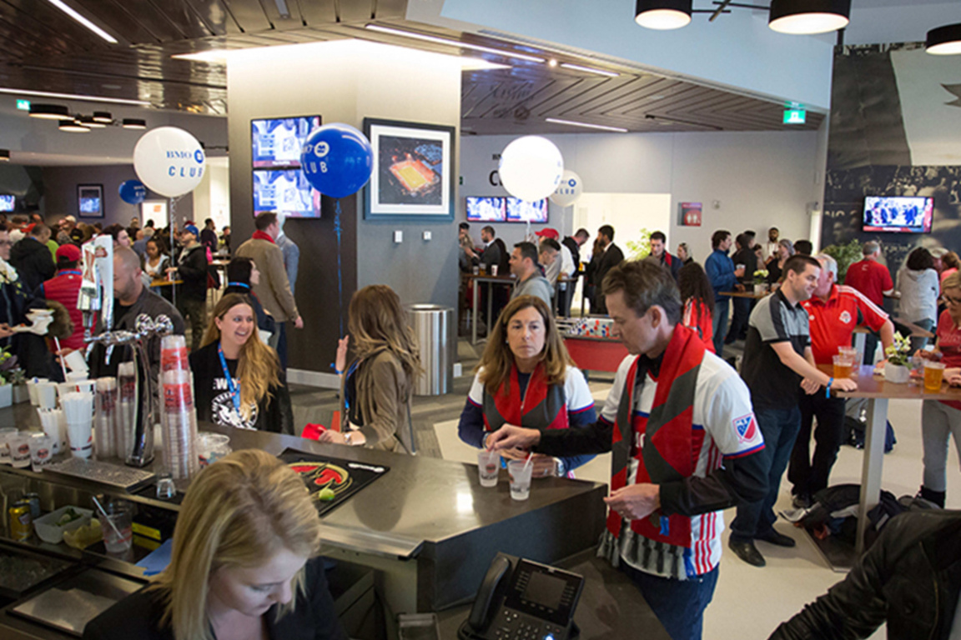
POTENTIAL ADVANTAGES
ENHANCED FAN ENGAGEMENT
DATA-DRIVEN MARKETING
INCREASED ATTENDANCE
COMPETITIVE
EDGE
Recognize and
reward loyalty
CREATE A
STRONGER EMOTIONAL
CONNECTION WITH
DEDICATED FANS
Tailor promotions based on weather forecasts
OPTIMIZE TICKET PRICING STRATEGIES
Incentivize attendance during typically low-turnout games
POTENTIALLY BOOST OVERALL SEASON ATTENDANCE
Unique approach in sports marketing
DEMONSTRATE INNOVATIVE USE OF DATA ANALYTICS IN FAN RELATIONS
Notes:
Let's explore the potential advantages of implementing an algorithm to in our sports marketing strategy. We've identified four key areas where this innovative approach could significantly impact our operations and fan relationships.
First, Enhanced Fan Engagement. Recognize and reward fans for their loyalty. This will create a stronger emotional connection to our dedicated supporters.
One idea is to promote a meet and greet. Wherein fans who attend the game will be part of a raffle. And the winner gets a chance to meet a player and have a jersey signed this is one of the most sooth after activity this can attract
fans to attend specially on those expected low attendance games.
Second, Data-Driven Marketing. By leveraging real-time data, we can tailor promotions based on factors like weather forecasts and optimize our ticket pricing strategies.
This approach ensures we're making informed decisions that resonate with our audience.
Third, Increased Attendance. The ability to incentivize attendance during typically low-turnout games. This targeted approach could potentially boost our overall season attendance figures.
By offering warm drink, heating or warm rooms during windy or snowy games.
Lastly, Competitive Edge. A unique approach in sports marketing. By demonstrating innovative use of data analytics in fan relations, we position ourselves at the forefront of the industry.
Differentiate from competitors by offering a more personalized, loyalty-focused approach. Like giving away free hot drinks or discounted warm scarfs or blankets using cold season. Personalized collectable memorabilia like signed football ball.

Slide 8

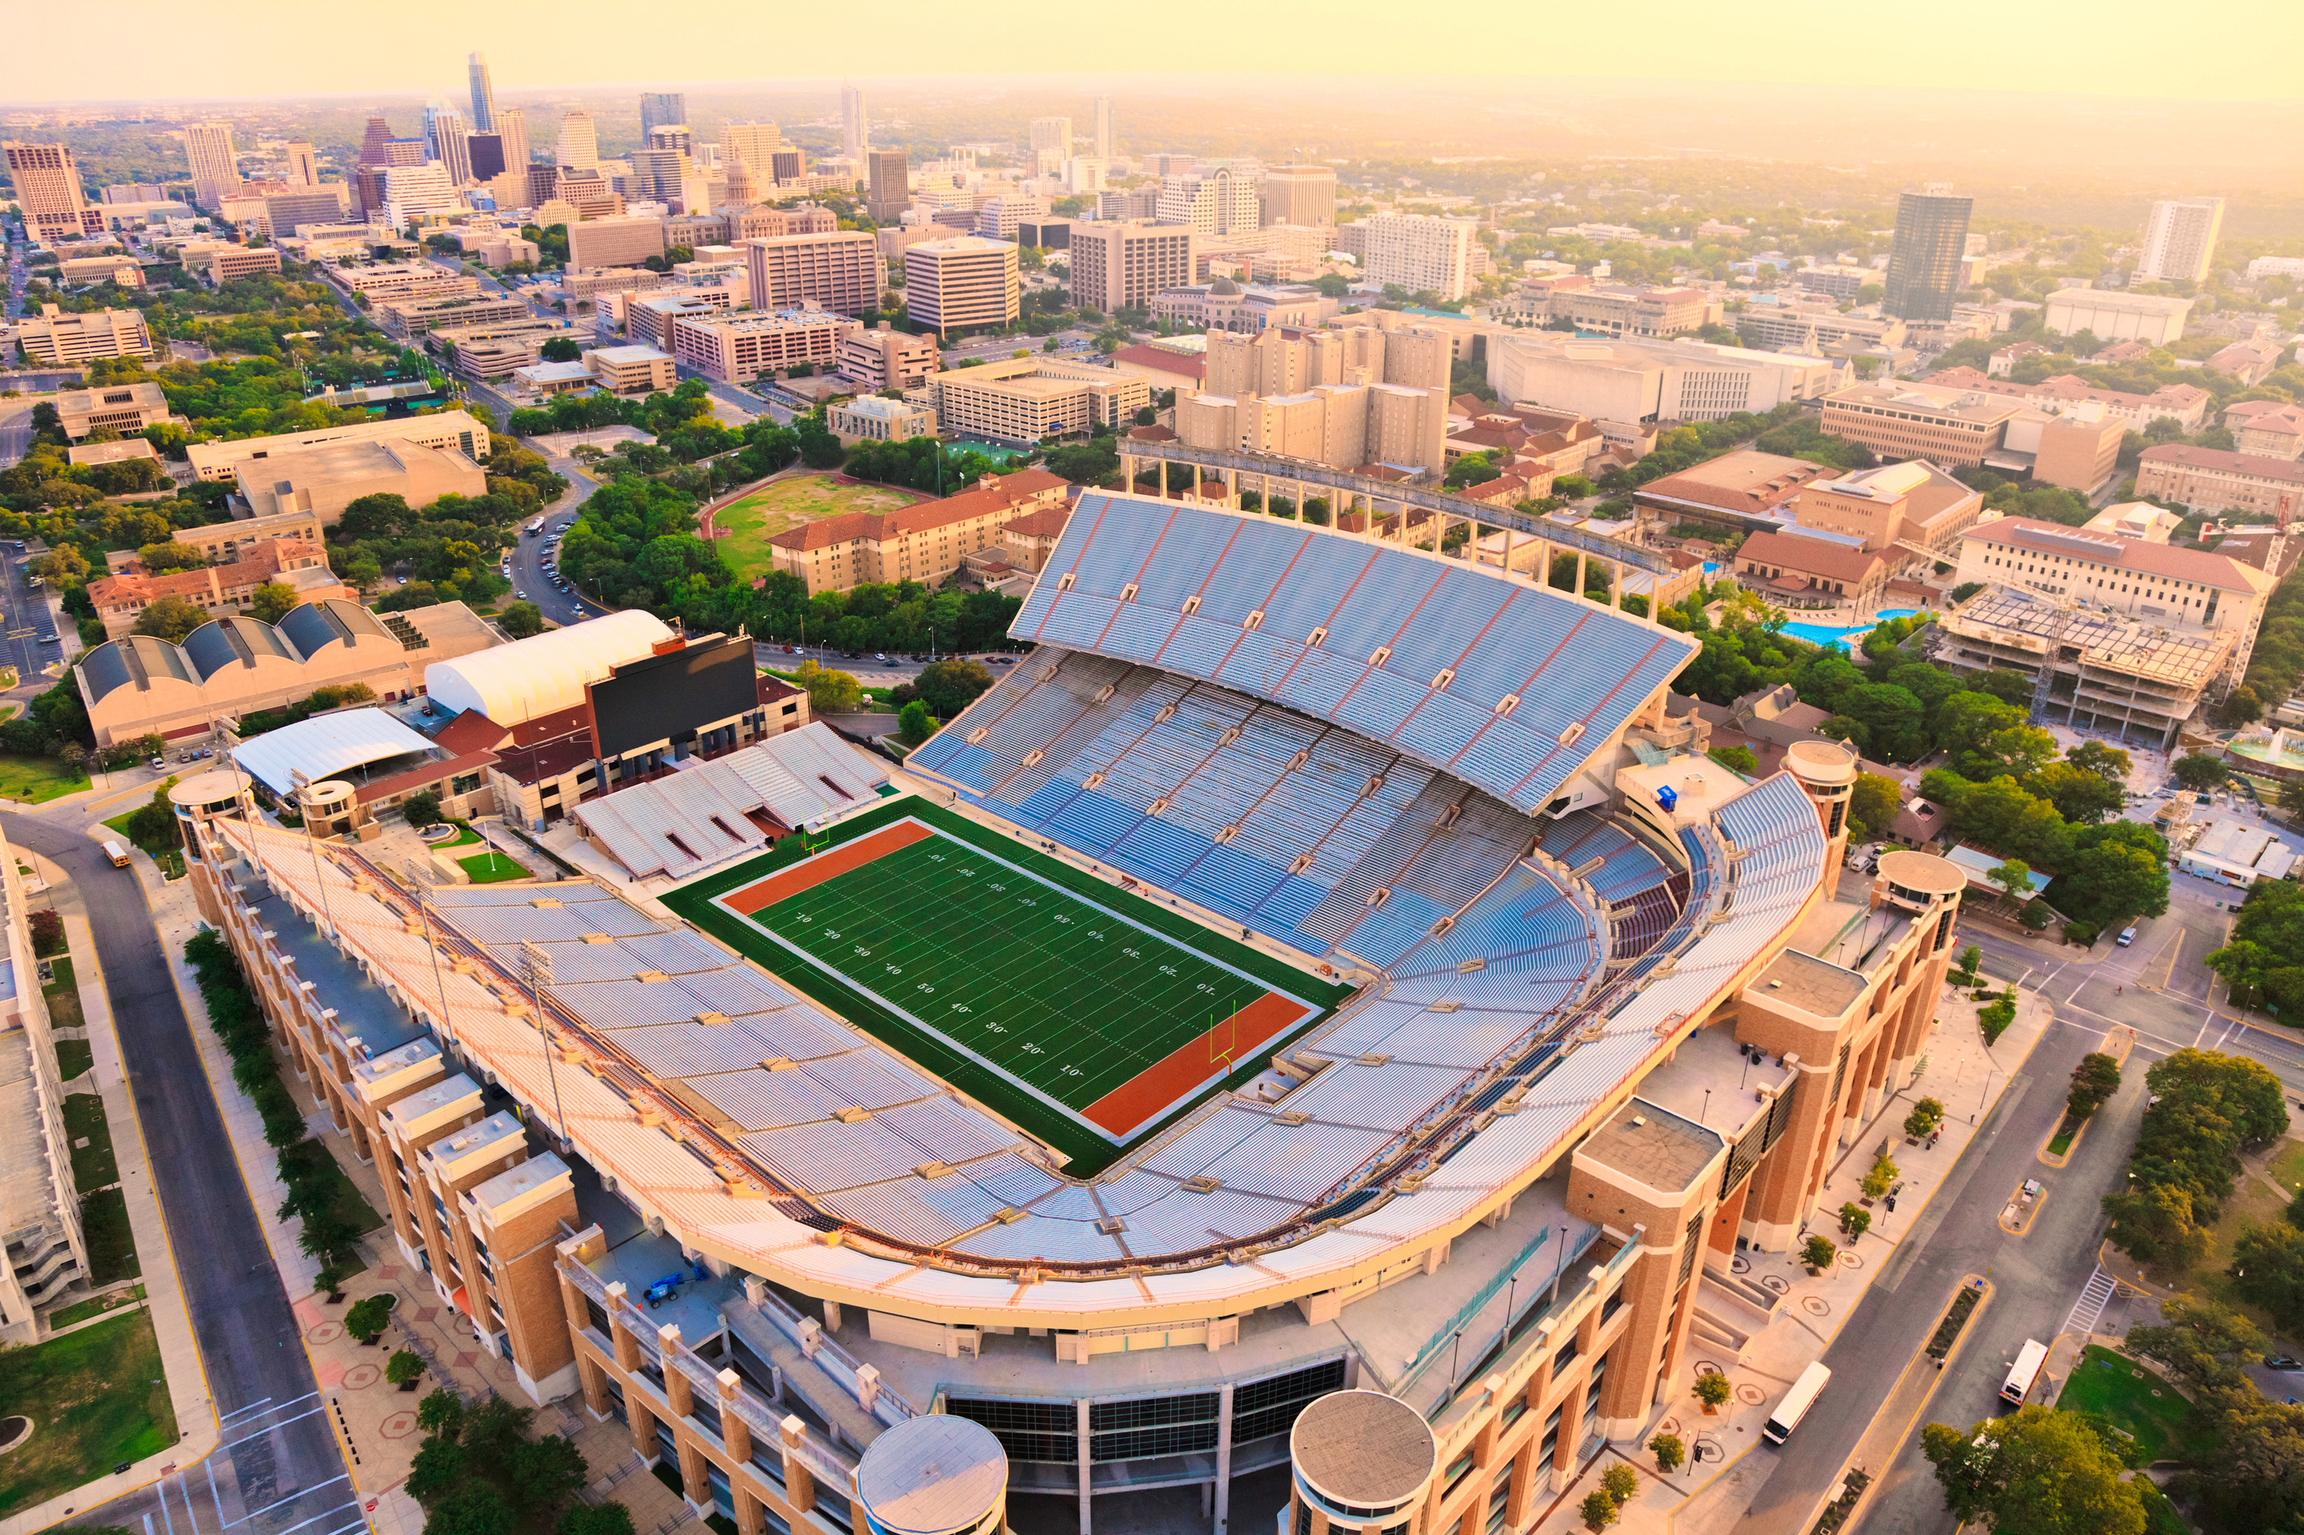
RECOMMENDATION
Developing the weather-attendance algorithm is practical and valuable for Toronto FC, enhancing fan engagement and recognizing loyalty. This data-driven approach will set a new standard in fan appreciation.
Notes:
From this feasibility study we recommend that developing a weather-attendance algorithm is practical and very valuable for Toronto FC, with this enhancing fan engement and the ability to recognize loyal fans with data driven approach will set a new standard in showing appreciation to the fans.

Slide 9

THANK YOU
REFERENCES:
https://en.wikipedia.org/wiki/BMO_Field
https://www.statista.com/topics/2892/major-league-soccer-mls
https://soccerstadiumdigest.com/2023-mls-attendance
https://api.open-meteo.com/v1/forecast
Weather Data Services | Visual Crossing

